Slide 1
Crisis Analysis from Social Media
Using Hadoop MapReduce
Storm Riders
Gaurav Shad
Nitesh Gupta
Abhishek Vellanki

Slide 2
Group project Description
List of Tasks
Task 1 – Deploying Hadoop on Cloud
Task 2 – Extracting Twitter data using FLUME
Task 3 – Designing Mapper and Reducer
Task 4 – Data Visualization
Task 5 – Developing user interface
Task 6 – Testing and Refining

Slide 3
Project Description (cont.)
Tasks allocation
 | Gaurav Shad | Nitesh Gupta | Abhishek Vellanki
Deploying Hadoop on Cloud | 34% | 33% | 33%
Extraction of Twitter Data using FLUME | 33% | 33% | 34%
Designing Mapper and Reducer | 33% | 34% | 33%
Data Visualization | 33% | 33% | 34%
Developing User Interface | 33% | 34% | 33%
Testing and Refining | 34% | 33% | 33%

Slide 4
Technical Details
Software used
  Apache Hadoop
  Open Stack
  Apache FLUME
  Twitter API
  Data Visualization – Big Insights or Spark

Slide 5
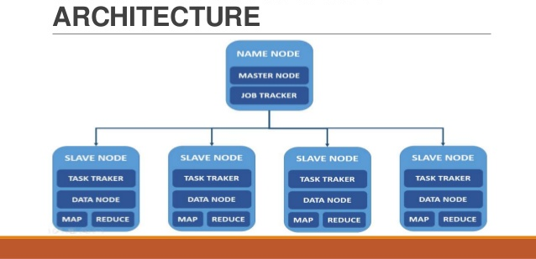
Technical Details
Project setup

Slide 6
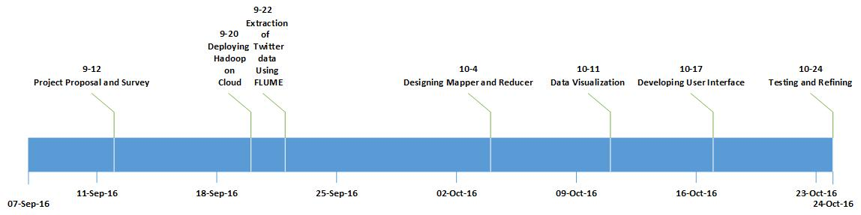
Technical Details
Roadmaps of your project

Slide 7
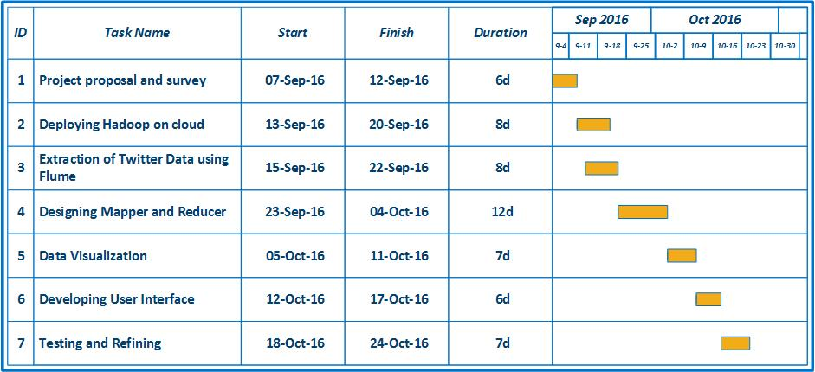
Technical Details
Roadmaps of your project

Slide 8
Technical Details
Social Media contains wide variety of data that can be analyzed to get meaning information. However the amount the data that needs to be analyzed is so big that its processing is inefficient on a single machine.
– This problem can be addressed by merging cloud computing and Hadoop to do distributed computing of data.

Slide 9
Technical Details (cont.)
We will setup Hadoop and configure its files and make a multi node cluster on a private cloud which is the main requirement to process the data.
The project concentrates on the data set retrieved from Twitter based on time filtering (like last 5 years) and process this data to represent end user how prone a region is to a crisis.
We will design a Mapper and Reducer which will filter tweets based on certain conditions similar to the ones used by NEIC (National Earthquake Information centre)

Slide 10
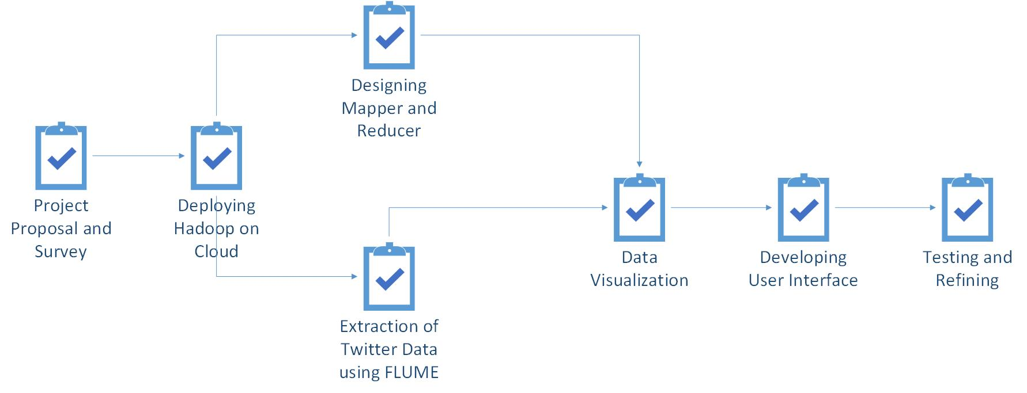
Technical Details (cont.)
Task Dependencies

Slide 11
Risks and Benefits
Novel aspects of this project:
  This project gives the user information not only about natural disasters but any large scale incident that grabs people’s attention
  The user can also enter the name of a crisis to figure out which regions it has hit
Risks/challenges:
  Issue can come up with configuration of XML files for Hadoop installation
  Lack of large data sets on twitter due to rate limit on twitter API
  Distinguishing useful tweets from others
Potential applications & benefits:
  The output from this project can be used to figure out which regions are prone to crisis

Slide 12
Tasks Accomplished by Now
Project proposal
Software Requirement Analysis
Information gathering for Hadoop
Established the parameters to filter the tweets

Slide 13
Conclusion
The project results in Data Visualization from the output of MapReduce algorithm.
The project returns a graphical representation of the crisis that has happened in the region queried by the user.
The tweets are streamed using Hadoop, FLUME and Twitter API.
Mapper and Reducer will be used to filter out the tweets and process the required data.
A User Interface will help the user interact with the application to get the required information.

Slide 14
Thank You !

